Slide 1
Exceptions
Jackie Kuehn

Slide 2
Why Use Exceptions?
Exceptions are a systematic, object-oriented approach to handling errors generated by C++ classes.
Exceptions are errors that occur at runtime.
Exceptions are caused by a wide variety of exceptional circumstances: not being able to open a file, running out of memory, trying to initialize an object with an impossible value, or using an out-of-bounds index to an array or vector.
In the C language programs returned an error value. Each time you made a call to a program, you had to check the return value. This requires a lot of if/else and code to handle errors.
In C++, the problem is more complex because errors with classes an error can occur without a function being explicitly called.
For example, class constructors are called implicitly, so there’s no return value to be checked.
Things are further complicated when an application uses class libraries. A class library and the application that makes use of it are often created by separate people. Problems occur occur by communicating with class libraries.

Slide 3
Exception Syntax
Imagine an application that interacts with objects of a certain class.
Ordinarily the application’s calls to the class member functions are not a problem. However, the application makes a mistake, causing the member function to notify the application that an error has occurred.
With exception, this is called throwing an exception.
In the application, a section of code to handle the error, this is called an exception handler or catch block.
Any code in the application that uses objects of the class is enclosed in a try block.
Errors generated in the try block will be caught in the catch block.
Code that does not interact with the class will not be in the try block.

Slide 4
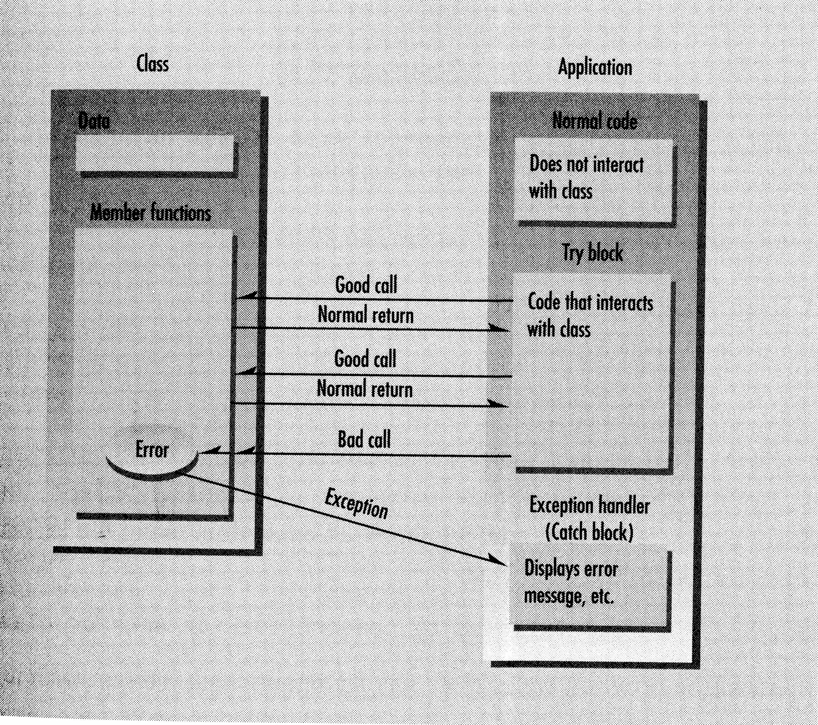
Exception Diagram

Slide 5
Example to Illustrate Exceptions
#include <iostream>
using namespace std;
const int MAX=3; //stack hold 3 ints
class Stack
{ private: int st[MAX]; int top;
public:
class Range{ } }; //note empty
Stack() {top = -1;}
void push(int a)
{ if(top>=MAX-1)
throw Range(); //throw exception
st[++top]=a;
}
int pop()
{ if(top<0) throw Range();
return st[top--]; }
};
int main()
{
Stack s;
try{
s.push(56);
s.push(29);
s.push(21);
// s.push(65); stack full
cout<<s.pop()<<endl;
cout<<s.pop()<<endl;
cout<<s.pop()<<endl;
cout<<s.pop()<<endl; //stack empty
}
Catch(Stack::Range)
{cout<<“Stack Empty or Full”<<endl;}
cout<<“Here after catch or normal exit”<<endl;
Return 0;
}

Slide 6
Specifying the Exception Class
The program first specifies an exception class within the Stack class:
class Range( ){};
The body of the class has no data and no member functions. The class body is not necessarily always empty.
The class name Range will be used to connect a throw statement with a catch block

Slide 7
Throwing an Exception
The previous class will throw an exception if the Stack class tries to pop a value when the stack is empty or push a value when the stack is full.
The member functions check for these exceptions using if statements.
The exception is used in both places with the statement:
throw Range();
The Range() part of this statement invokes the implicit constructor for the Range class, which creates an object of this class.
The throw part of the statement transfers control to the exception handler.

Slide 8
The try block
All the statements in main90 that might cause this exception are preceded by the try keyword.
These are the statements that manipulate the stack object.
This code in the try block is part of the application’s normal code.
There can be many try blocks in your program, so you can access Stack objects from different places.
try{
//code that operates on objects that might
//cause an exception
}

Slide 9
The Exception Handler (Catch Block)
The code that handles the exception is enclosed in braces, preceded by the catch keyword, with the exception class name in parentheses.
The exception class name must include the class in which it is located.
catch (Stack::Range)
{//code that handles the exception}
This code is called the exception handler.
The exception handler immediately follows the try block.
The exception handler may “fall through” to the bottom of the handler or may transfer control elsewhere or most often terminate the program.

Slide 10
Sequence of Events when an Exception Occurs
1. Code is executing normally outside a try block.
2. Control enters the try block.
3. A statement in the try block causes an error in a member function.
4. The member function throws an exception.
5. Control transfers to the exception handler (the catch block) following the try block.

Slide 11
Exceptions with Arguments
What happens if an application needs to know more information about what caused an exception?
In our example, it would help to know the value of the faulty inches.
Also, if the same exception is thrown by different member functions it would be helpful to know which of the functions was the culprit.
Can you pass information from the member function, when the exception is thrown, to the application that handles it. YES YOU CAN…..
Throwing an exception involves not merely transferring control to the handler but also creating an object of the exception class by calling its constructor. throw ExceptIn();
If we add data members to the exception class, we can initialize them when we create an exception object.
The exception handler can retrieve the data when it catches the exception.
It’s like writing a message on a baseball and throwing it over the fence to your neighbor. ☺

Slide 12
Data in an Exception Class
Data in an exception class should be public so that it can be handled directly by the exception handler.
The data value string origin will give the name of the function causing the exception.
The data value int badInches will give the value of the data that caused the exception.
The exception class was initialized in the two following ways:
throw ExceptIn(“Two Arg Constructor”, inch);
throw ExceptIn(“Get Length Function”, inches);
Extracting data from the Exceptin object was done as follows.
catch(Distance::Exceptin iprob)
Programmer can access iprob.origin, the name of the culprit.
Also, the applications programmer can access iprob.badInches to get the value of inches that caused the exception.

Slide 13
Exceptions
An important problem solved by exceptions is that of errors in class libraries. A library routine may discover an error, but it typically doesn’t know what to do about it.
The class library and application program are usually written by different people at different times. Thus, it is darn helpful for the class to throw an exception, so the application programmer can do something about it.
If you’re writing a class library, you should write exceptions for anything that could cause problems for the user.
Exceptions should not be used for every kind of error because there is overhead involved → For example, user input error that are easily detected by the program should be done with normal decision code.

